Slide 1





PRT Model: Particle Tracking in MODFLOW 6
By the MODFLOW Development Team
MODFLOW 6 and FloPy: Take Your Modeling to the Next Level
Princeton, New Jersey, USA
Friday, May 31 – June 1, 2024

Slide 2
MODPATH 7
Separate program from MODFLOW
Compatible with various versions of MODFLOW, including MODFLOW 6
Particle tracking across rectangular cells using “Pollock’s method”
Rectangular grids (DIS)
Quad-refined grids (DISV, DISU)

Slide 3

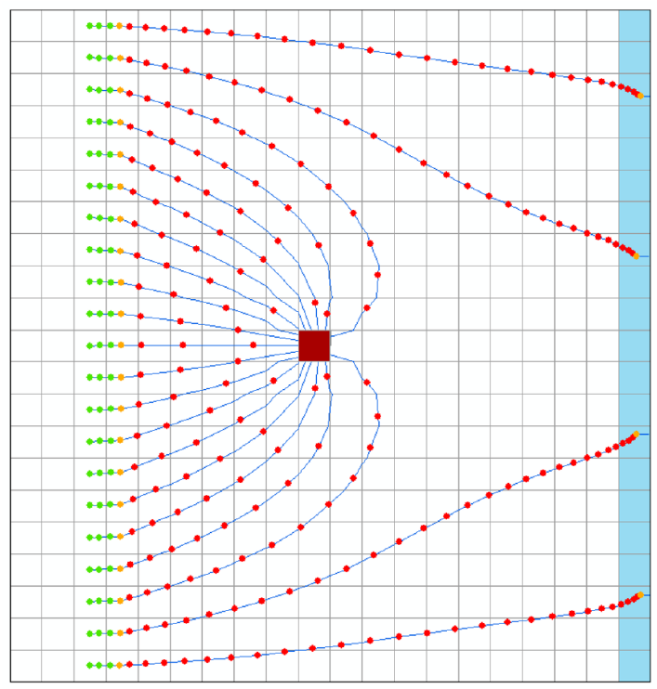
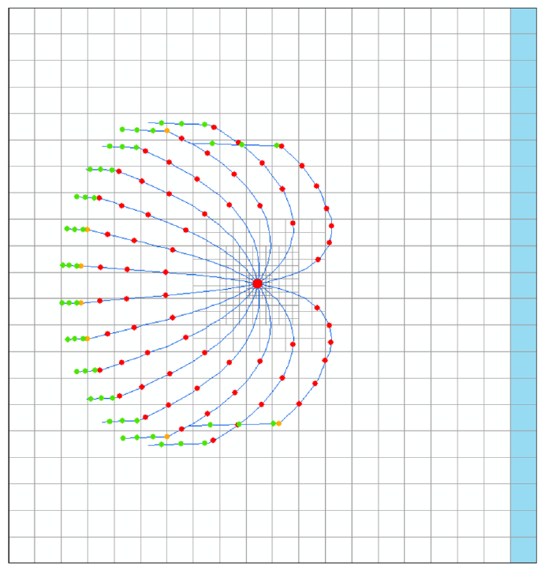
MODPATH 7
RECTANGULAR GRID
QUAD-REFINED GRID
From MODPATH Version 7 Example Problems

Slide 4
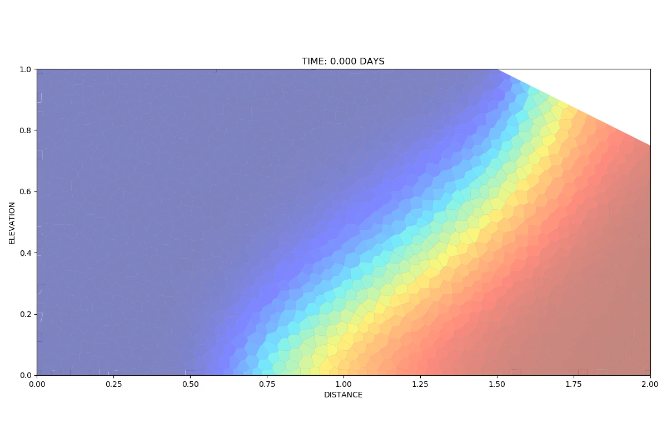
What about particle tracking on really unstructured MODFLOW 6 grids?

Slide 5
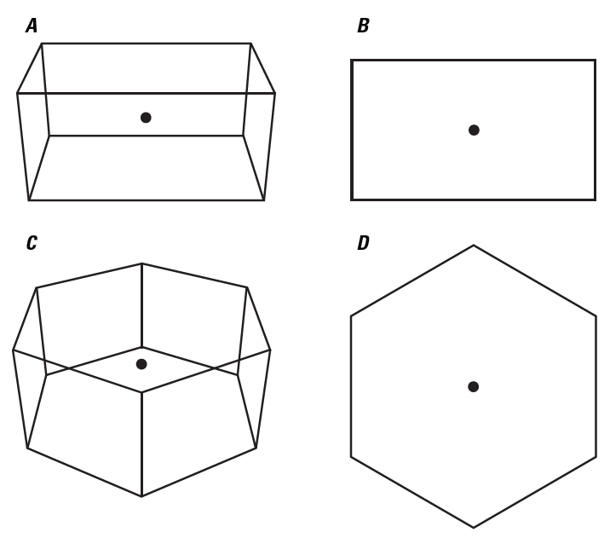
PRT Model for MODFLOW 6
Integrated into MODFLOW 6
Particle tracking across rectangular cells using “Pollock’s method”
Rectangular grids (DIS)
Quad-refined grids (DISV)
Particle tracking across non-rectangular (polygonal) cells of the kind that make up DISV grids
From USGS TM 6-A55
GENERALIZATION OF POLLOCK’S METHOD

Slide 6
Pollock’s method
Independent, 1D, linear interpolations of v_{x} and v_{y} on a rectangle
Solves analytically for exit time & location
Simple and elegant!
v_{y}
v_{x}
v_{x}
v_{y}

Slide 7
Pollock’s method from another angle
Define vertex velocities
a la Hægland et al (2007) Advances in Water Resources

Slide 8
Pollock’s method from another angle
Define vertex velocities
Interpolate linearly between them (“barycentric” interpolation)
Same idea in the upper triangle
50%
10%
40%

Slide 9

Pollock’s method from another angle
On a rectangle, equivalent to Pollock’s interpolation
50%
10%
40%

Slide 10
Generalizing Pollock’s method
Polygonal cell
Given edge normal velocities
Define vertex velocities

Slide 11
Generalizing Pollock’s method
Polygonal cell
Given edge normal velocities
Define vertex velocities
Triangulate
Barycentric interpolation

Slide 12
Tracking across triangular subcell
Formulate linear ODEs for trajectory
Solve for trajectory analytically
Solve for exit location & time (1D root finding exercise)
γ =0 edge

Slide 13
Solving for the exit point
Identify outflow interval for edge
Further constrain using properties of analytical solution
Find intersection of trajectory with outflow interval
α{t}=0
“bracket” the root
looking for root α{t}=0

Slide 14
Solving for the exit point

Slide 15
Solving for the exit point
Brent’s method
Combination of secant method and bisection
Keeps root bracketed
Bottom line: our method is “semi-analytical”

Slide 16
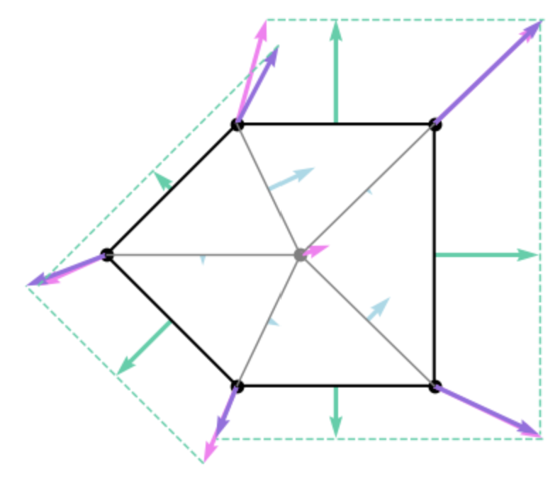
Features of our generalized Pollock’s method
Our method is new, but it’s related to the methods reviewed by Zhang et al. (2012, WRR, v. 48):
Triangular subcells
Relatively low-order basis functions, with uniform normal velocities along cell edges and variable normal velocities along internal subcell edges
Subcells share a single cell-centroid velocity
Locally conservative

